Slide 1


Lakshminarasimhan Madrassudarsan
Dec 25, 2021

Slide 2

Outline
Executive Summary ………..(slide 3)
Introduction ………………..(slide 4)
Methodology ………………(slide 6)
Results ……………………..(slides 17-44)
Conclusion …………………(slide 45)
Appendix …………………(slide 46)

Slide 3
Executive Summary
The objective of this thesis is to apply a complete data-driven analytic approach to predict favorable outcome to winning the space race with SpaceX landing data
It involves data collection, data wrangling, EDA with data visualization, EDA with SQL, Building interactive map with Folium, Building a Dashboard with Plotly Dash and Data Classification using Predictive Analysis methodologies
The results are summarized with Exploratory data analysis results, Interactive analytics demo (with screenshots) and Predictive analysis results
Summary of methodologies
Summary of results

Slide 4
Introduction
In the age of commercial space travelling, SpaceX advertises on its website that Falcon 9 rocket launches 260+% cheaper (with a cost of 62 million dollars while other providers cost upward of 165 million dollars each), much of the savings is because SpaceX can reuse the first stage
Will SpaceX land successfully in first stage?
What are the parameters that influence its optimal success in landing?
How to leverage the insight to potentially bid against SpaceX for rocket launch?
Project background and Context
Problems to find answers

Slide 5


Slide 6
Methodology
Data collection methodology:
The data was collected by sending get request to SpaceX API and by web scraping Falcon 9 and Falcon Heavy Launches Records from Wikipedia.
Perform data wrangling
Dealing with missing values, creating new columns, dropping irrelevant columns and visualizing through Panda's data frames
Perform exploratory data analysis (EDA) using visualization and SQL
Perform interactive visual analytics using Folium and Plotly Dash
Perform predictive analysis using classification models
Chose the best performing model from testing four different models of classification: Logistic regression, Tree, SVM and KNN

Slide 7
Data Collection
The data is collected from the SpaceX REST API, and the API will give us data about launches including information about the rocket used, payload delivered, launch specifications, landing specifications, and landing outcome.
Another data is collected from Wikipedia using BeautifulSoup
How was the data collected?
Use SpaceX REST API
API returns data in JSON
Normalize into flat (.csv) data file
Get HTML response from Wikipedia
Extract using BeautifulSoup
Normalize into flat (.csv) data file
Data collection process
SpaceX API
Web Scraping

Slide 8
Data Collection – SpaceX API
SpaceX REST calls using key phrases and flowcharts
Request and parse the SpaceX launch data using the GET request
Decode the
response content as a Json using json ()
and turn it into a Pandas dataframe
using.json_normalize
Use the API again to get
information about the launches using the IDs
given for each launch. Specifically, will be
using columns
Rocket
Payloads
Launchpad
Cores
GitHub URL
Data Collection API.ipynb (github.com)
The mean and the replace () function to replace
np.nan ` values in the data with the mean
calculated

Slide 9
Data Collection - Scraping
Web scraping process
GitHub URL
Extract a Falcon 9 launch records HTML table from Wikipedia
Parse the table and convert it into a Pandas data frame
TASK 1: Request the Falcon9 Launch Wiki page from its URL
TASK 2: Extract all column/variable names from the HTML table header
TASK 3: Create a data frame by parsing the launch HTML tables
Web Scraping.ipynb (github.com)

Slide 10
Data Wrangling
Data Wrangling process
GitHub URL
Data was processed using pandas data frame features
Data Wrangling process contains 5 steps for understanding data
1) Data Analysis
2) Calculate number of launch on each site
3) Calculate the number of occurrence of each orbit
5) Create a landing outcome label
from Outcome column
4) Calculate the number and
occurrence of mission outcome per orbit type
SpacexDataWrangling.ipynb (github.com)

Slide 11
EDA with Data Visualization
Visualization charts and reason for the choice of the chart
Scatter Graphs helps to visualize the data - show the data pattern & identify correlation between variables. Scatter plots consist of a larger body of data - Fight Number vs. Payload Mass, Fight Number vs. Launch Site, Payload vs. Launch Site, Orbit vs. Fight Number, Payload vs. Orbit Type, Orbit vs. Payload Mass
Bar Graph makes it easy to compare sets of data between different groups immediately. The graph represents categories on one axis and a discrete value in the other. The goal is to show the relationship between the two axes. Bar charts can also show big changes in data over time. Mean vs. Orbit
Line Graphs are useful in that they show data variables and trends very clearly and can help to make predictions about the results of data not yet recorded
GitHub URL
jupyter-labs-eda-dataviz (1).ipynb (github.com)

Slide 12
EDA with SQL
SQL Queries performed to explore the dataset
Display the names of the unique launch sites in the space mission
Display 5 records where launch sites begin with the string 'CCA'
Display the total payload mass carried by boosters launched by NASA (CRS)
Display average payload mass carried by booster version F9 v1.1
List the date when the first successful landing outcome in ground pad was achieved
List the names of the boosters which have success in drone ship and have payload mass greater than 4000 but less than 6000
List the total number of successful and failure mission outcomes
List the names of the booster versions which have carried the maximum payload mass. Use a subquery
List the failed landing outcomes in drone ship, their booster versions, and launch site names for in year 2015
Rank the count of landing outcomes (such as Failure (drone ship) or Success (ground pad)) between the date 2010 06 04 and 2017 0 3 20, in descending order
GitHub URL
EDA with SQL.ipynb (github.com)

Slide 13
Build an Interactive Map with Folium
Marked all launch sites visually on a map with latitude, longitude coordinates circled
Marked the success/failed launches for each site, assigned the data frame launch_outcomes (failures, successes) to classes 0 and 1 with Green and Red markers on the map in a MarkerCluster()
Calculated the distance from the launch site to various land markers. Lines are drawn on the map to measure distance to landmarks
This helps to answer below questions easily:
Are launch sites in close proximity to railways?
Are launch sites in close proximity to highways?
Are launch sites in close proximity to coastline?
Do launch sites keep certain distance away from cities?
Folium map Summary
GitHub URL
Interactive Visual Analytics with Folium lab.ipynb (github.com)

Slide 14
Build a Dashboard with Plotly Dash
Plotly is a python wrapper on the JavaScript library 'leaflet'. It enables us to interact with our data visualizations and host it as a website:
What’s included:
Pie Chart: That shows number of launches from each launch site as well as number of successful and failed launches from those sites
Callback function for `site dropdown` as input, `success pie chart` as output
Callback function for `site dropdown` and `payload slider` as inputs, `success payload scatter chart` as output
Scatter Graph: Relationship between the success of a launch (Outcome) and Payload (in kg) for different versions of boosters
Dashboard Summary
GitHub URL
Capstone-SpaceX-Launch/Dashboard at main · msln007/Capstone-SpaceX-Launch (github.com)

Slide 15
Predictive Analysis (Classification)
Building Model
Load dataset into NumPy and Pandas and Transform data.
Evaluating Model
Check accuracy for each model Get tuned hyperparameters for each type of algorithms and Confusion matrix for the same
Improvimg Model
Use feature engineering and model tuning
Split data into Training and Test datasets
Standardize/Normalize all the parameters
Finding the best model
Find the best performing classification model Find the model with best accuracy score and also the best performing parameters/variables for that model
Classification Model Summary
GitHub URL
SpaceX-ML-Prediction.ipynb (github.com)

Slide 16
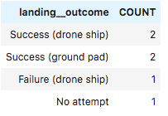
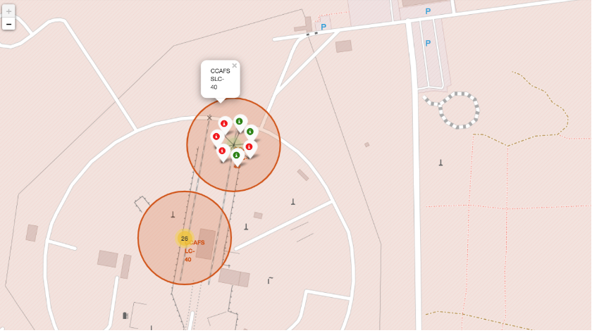
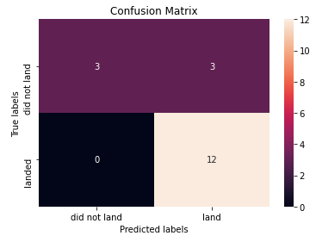
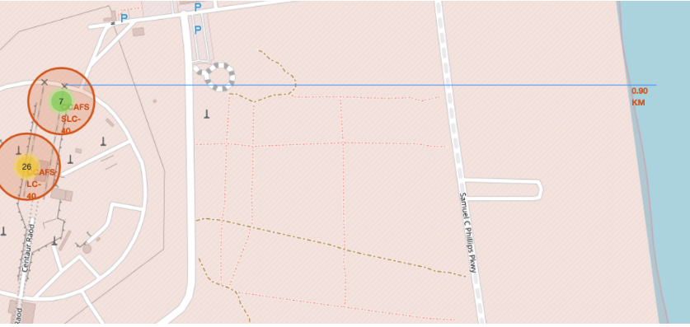
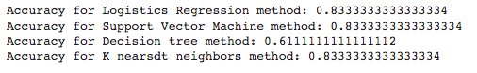
Results
Exploratory data analysis results
Interactive analytics demo in screenshots
Predictive analysis results

Slide 17


Slide 18
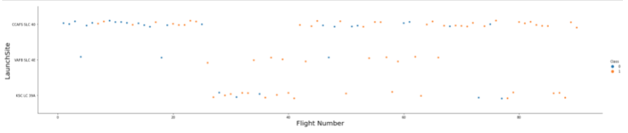
Flight Number vs. Launch Site
“Depicts the total launches by flight and launch site. The CCAFS SLC 40 has most launches across all flight numbers and have most failed launches in lower flight numbers and reduces as flight number increases”

Slide 19
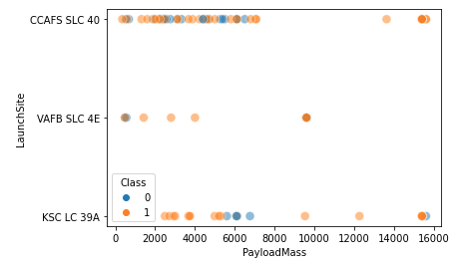
Payload vs. Launch Site
“No launches of VAFB SLC 4E beyond 10000 PayloadMass. No failed launches in the 8000-15000 PayloadMass range and just 1 failed launch of KSC LC 39A in the 8000-16000 range”

Slide 20
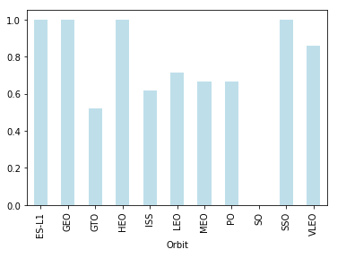
Success Rate vs. Orbit Type
“ES-L1, GEO, HEO and SSO have 100% Success Rate”

Slide 21
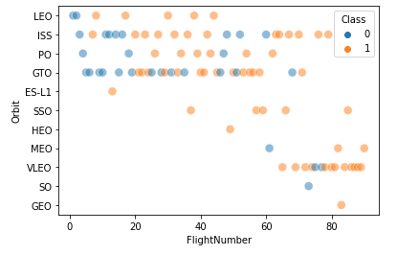
Flight Number vs. Orbit Type
“LEO Orbit, SSO, HEO, GEO seems to have direct correlation to Success and GTO Orbit seems to have Failures at all Flight Numbers”

Slide 22
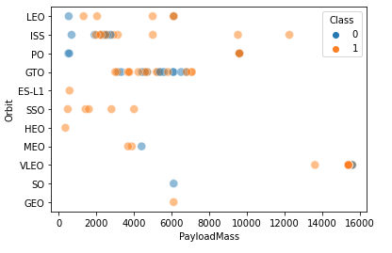
Payload vs. Orbit Type
“LEO, ISS, PO, SSO seems to have direct correlation to Success by PayloadMass. While SSO has high Success in lower PayloadMass, LEO, ISS, PO have higher Success in higher PayloadMass category”

Slide 23
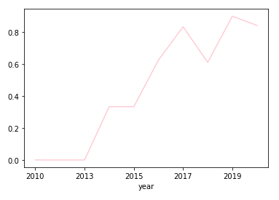
Launch Success Yearly Trend
“Overall, there’s continuous increase in Success Rate from 2013-2020 years range (despite a flat 2014 and a small dip in 2018)”

Slide 24
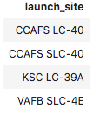
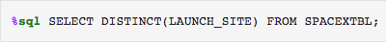
All Launch Site Names
“Selecting unique launches sites from LAUNCH_SITE column from SpaceX launches dataset using SQL Query”

Slide 25
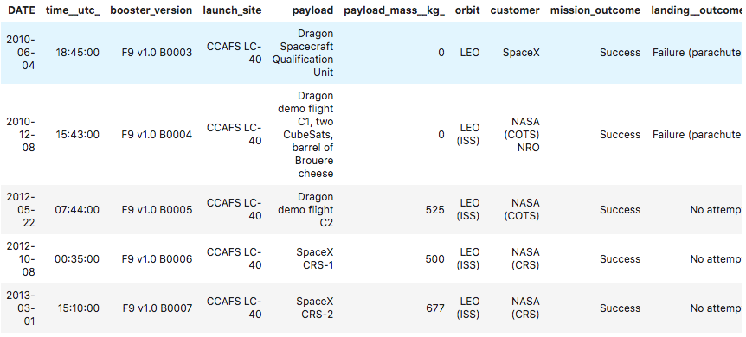
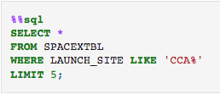
Launch Site Names Begin with 'CCA'
“Selecting 5 records from SpaceX dataset with Launch Site names starting with CCA”

Slide 26
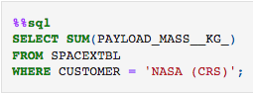
Total Payload Mass
“Calculating total of all booster’s ‘Payload Mass’ from SpaceX dataset launches by ‘NASA (CRS)’ customer”

Slide 27
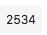
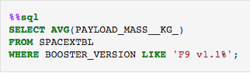
Average Payload Mass by F9 v1.1
“Calculating average payload mass of Booster version F9 v1.1 only”

Slide 28
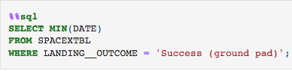
First Successful Ground Landing Date
“Calculating first successful ground landing date using MIN function on landing date column”

Slide 29
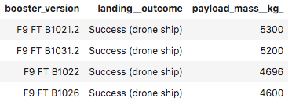
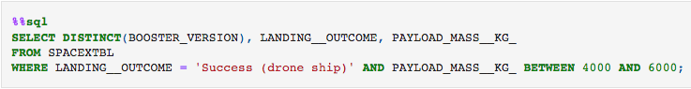
Successful Drone Ship Landing with Payload between 4000 and 6000
“Getting list of booster versions which have successful drone ship landing and their payload is in the range of 4000 to 6000 KG”

Slide 30
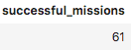
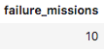
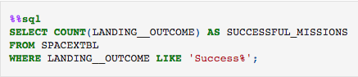
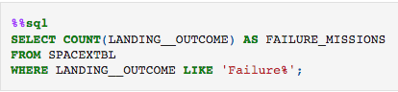
Total Number of Successful and Failure Mission Outcomes
“Getting count of total successful and failure missions from SpaceX dataset based on landing outcome name starting with ‘Success’ for successful missions and ‘Failure’” for failure missions”

Slide 31
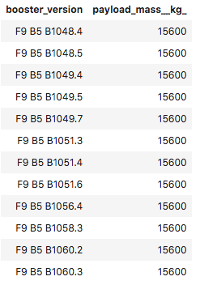
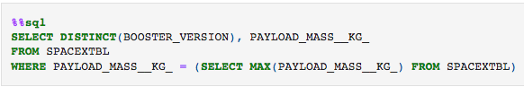
Boosters Carried Maximum Payload
“Obtained boosters carrying maximum payload by first selecting maximum of payload from SpaceX dataset and then selecting the booster version, payload using a subquery (query inside a query)”

Slide 32
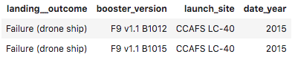
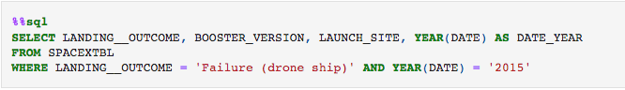
2015 Launch Records
“Get list of failed landing_outcome along with the booster version and launch site for the year 2015 from SpaceX table using WHERE clause”

Slide 33
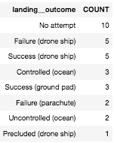
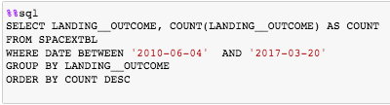
Rank Landing Outcomes Between 2010-06-04 and 2017-03-20
“Obtained count of landing_outcome in descending order occurred between above 2 dates by GROUP BY and ORDER BY clauses ”

Slide 34


Slide 35
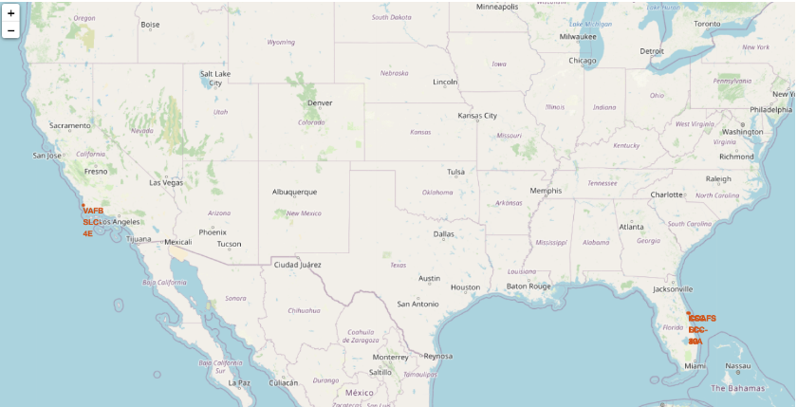
Launch Sites On A Map
“SpaceX launch sites are in– Florida on the USA east coast and California on the USA west coast”

Slide 36
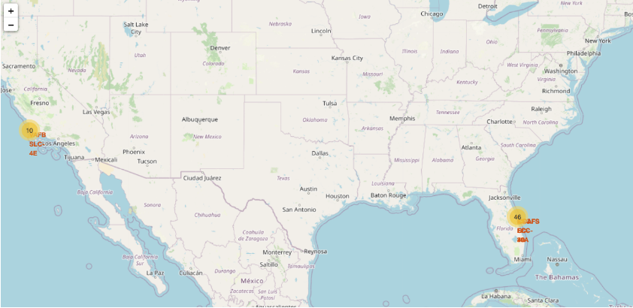

Sites And Launch Outcomes On A Map
“Green colored are the successful launches and red colored are the failed launches”

Slide 37

Launch Site Proximities On A Map
coast
highway
road
“Here, we can observe distance of launch sites from east coast, highways, key road, railway line visualized”

Slide 38


Slide 39
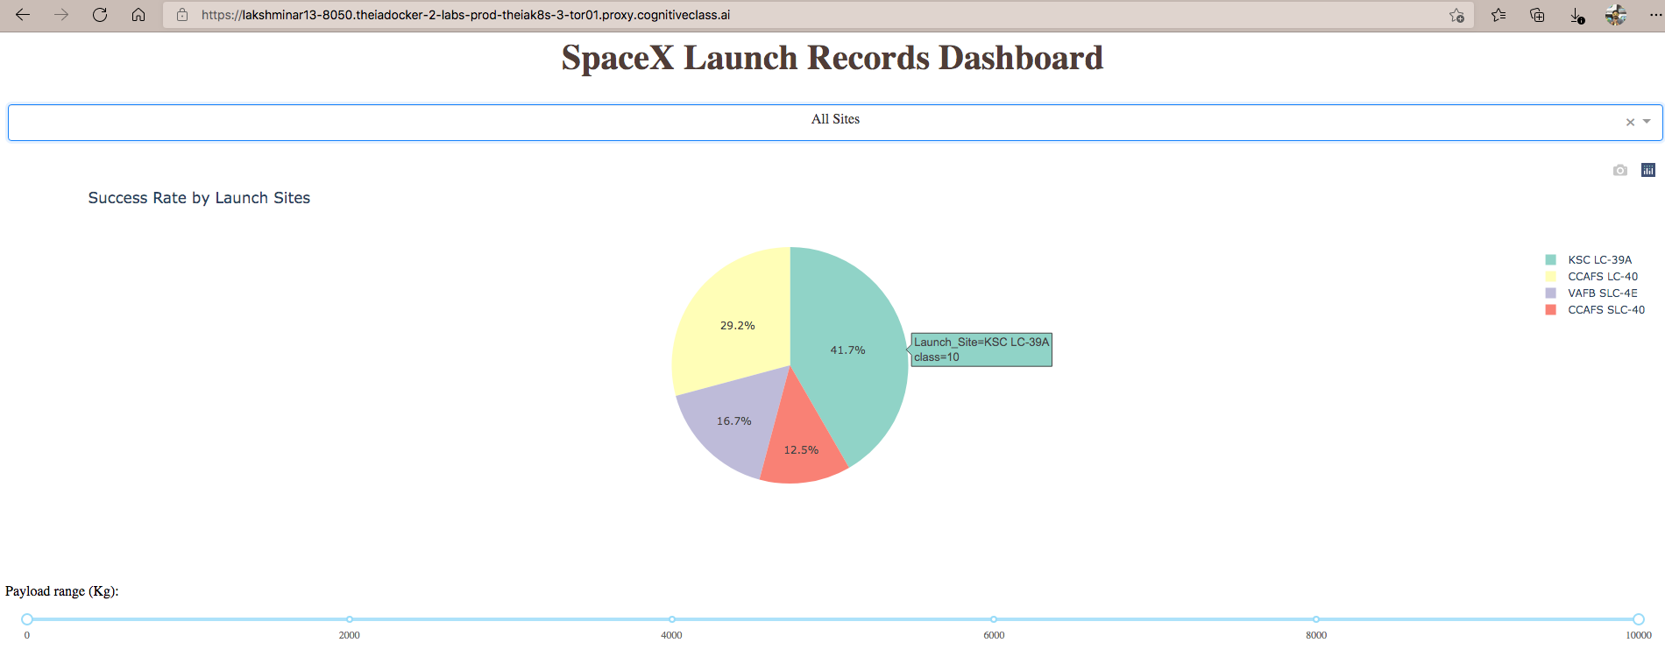
Success Rate by Launch Sites
This site KSC LC-39A has the most successful launches

Slide 40
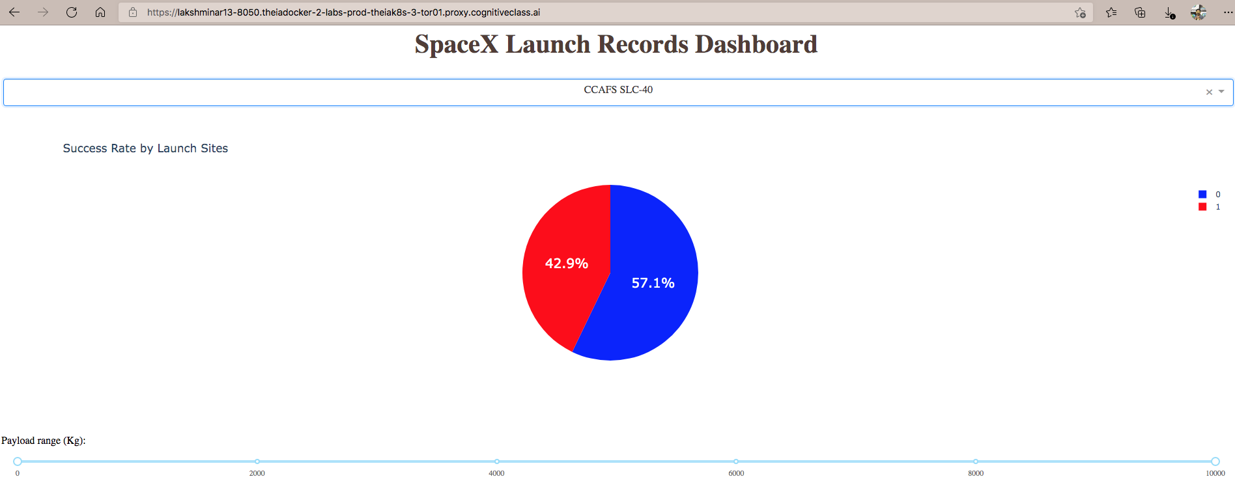
Most Successful Launch Site
This site CCAFS SLC-40 has the most success Rate

Slide 41
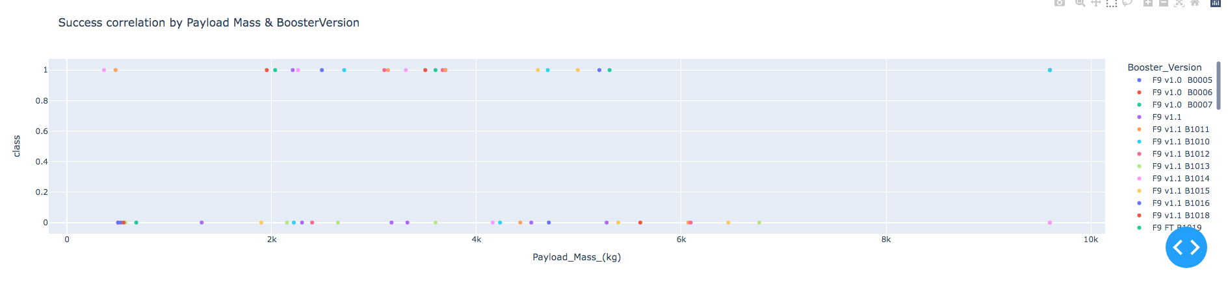
Success by Payload Mass & Booster Version
Lower payload launches are more successful
“Lower Payload launches (up to 6,000 kg) are more successful”

Slide 42


Slide 43
Classification Accuracy
“KNN, Support Vector & Logistic Regression Methods have high accuracy”

Slide 44
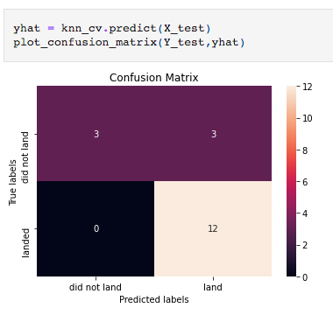
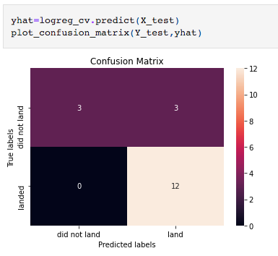

Confusion Matrix
“The above confusion matrix shows that all 3 models – KNN, Logistic Regression & SVM have highest true positives and least false negatives"

Slide 45
Conclusions
KNN, Logistic Regression and SVM are the best classifier models for this dataset
The lower payload launches have higher success rate than heavier payloads
Site KSC LC-39A has the most successful launches from all sites
F9 Booster versions v1.0, v1.1, FT, B4, B5 have the highest launch success rates
The SpaceX launches have been continuously getting better from year 2013 to 2020 based on data so they have the best chances for perfecting their launches in the future years

Slide 46
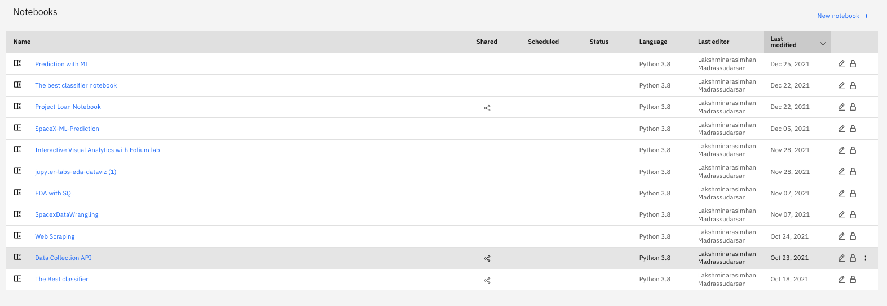

Appendix
IBM Cloud Pak Assignments
My GitHub, Gists

Slide 47


